Slide 1
Case study 2 for team 3
Team member:
Lei Zhenghong
Peng Yuqi
Wang Weichen

Slide 2
Brief Summary
What we focused on | Brief summary of our findings
The causal drivers responsible for the number of buy/sell transactions a user will make in the next week. | Future buy transaction: buying times history (positive), total events history (positive), stock screen visiting history (positive), deposit times history (positive). Futute sell transaction: selling times history (positive), stock screen visiting history (positive), buying times history (positive).
The causal drivers responsible for the transaction values a user will make in the next week. | The buy/sell values, net flow and the history total events have positive impact on the future transaction values.
Different model insights for the segments of users in Use Case 1. | The observations are similar with our exploration of four groups of users in case study one.
The implications for the marketing strategy | Build community, rewarding, notification and optimizing UI design.

Slide 3
Create Target Variable
Regression Target:
How many buy/sell will a user make in the next 7 days; How much transaction value will a user make in the next 7 days?
Create Model Features
Trades
Deposit and Withdrawal
Usage Behaviour
Personal Information
Number of buy transactions(7&14 days)
Amount of buy transactions(7&14 days)
Number of sell transactions(7&14 days)
Amount of sell transactions(7&14 days)
Changes in sell/buy values
Changes in sell/buy numbers
Net Flow
Market situation
Number of withdrawals(7&14 days)
Amount of withdrawals(7&14 days)
Amount of deposit(7&14 days)
Number of deposits (7&14 days)
Churn percentage
Session length(7&14 days)
Total events(7&14 days)
Changes in session length
Changes in total events
Screen (Stock) event Count
Tap (Stock) event Count
Tap (Withdraw) event Count
Source of wealth
Employment status

Slide 4
Train and Evaluate Model
Target variable:
The target variable is setted to be the next week‘s transaction numbers/values of each users.
Regression Model:
Gradient Boosting Regressor:
Be able to capture nonlinear relationships in the data.
Be able to process data sets containing numerical and categorical features.
Be able to capture the complex interactions between features.
Cross validation: 10 fold
Grid Search (GridSearchCV)
 | MAE | RMSE | R2 Score
The number of buying
Baseline model | 1.45 | 8.35 | 0.20
Gradient Boosting Regressor | 1.11 | 6.18 | 0.58
The number of selling
Baseline model | 1.00 | 5.28 | 0.20
Gradient Boosting Regressor | 0.77 | 3.88 | 0.59
Transaction value
Baseline model | 1293 | - | 0.20
Gradient Boosting Regressor | 1059 | - | 0.50

Slide 5
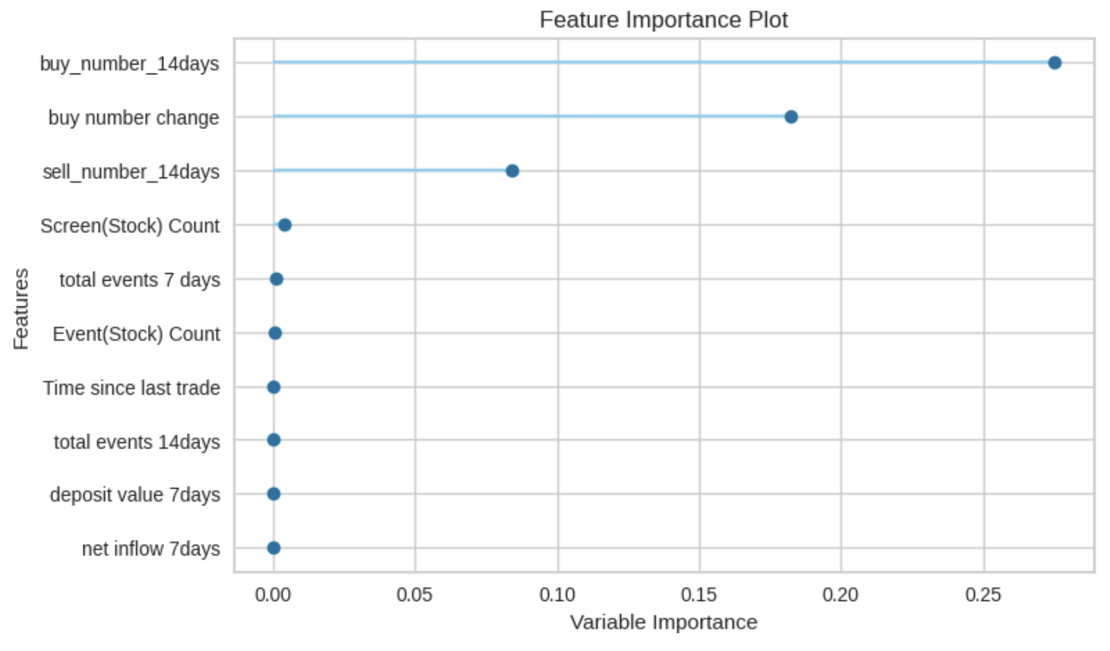
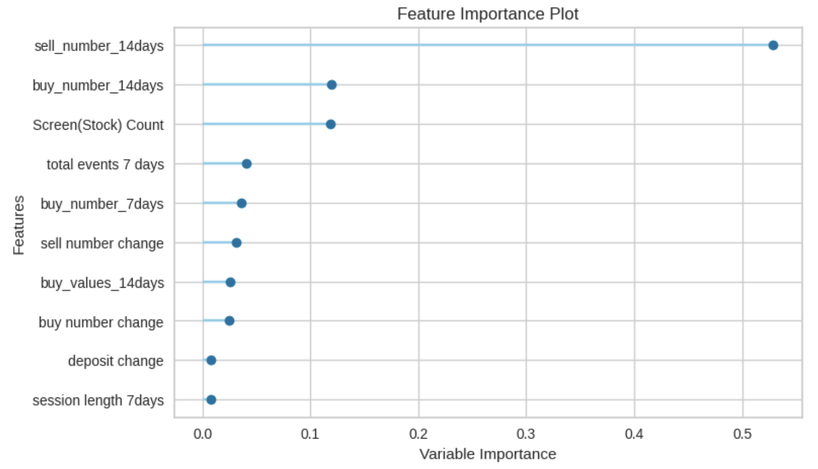
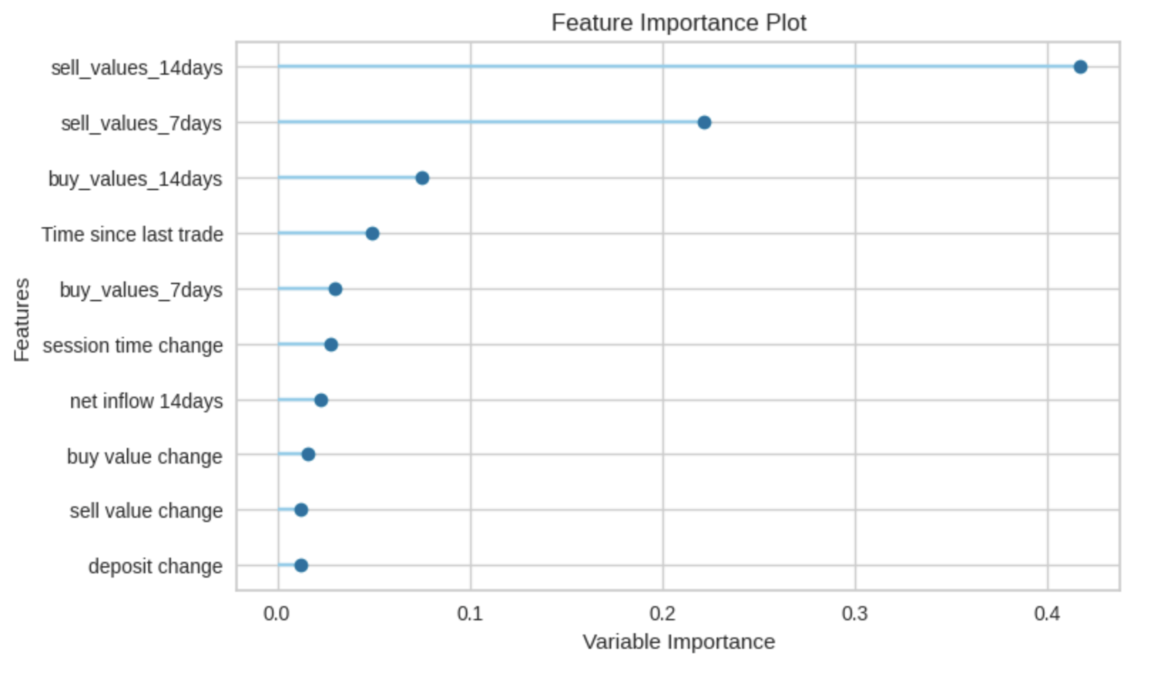
Feature Importance
Regression Target: The number of buy trading will a user make in the next 7 days.
Regression Target: The number of sell trading will a user make in the next 7 days.
Regression Target: The transaction values will a user make in the next 7 days.
The number of buying in past 14 days.
The changing of number of buying between past 7 days and 14 days.
The number of selling in past 14 days.
The number of selling in past 14 days
The number of buying in past 14 days
The count of visiting screen that related to “Stock”
The number of selling in past 14 days
The number of selling in past 7 days
The number of buying in past 14 days.

Slide 6
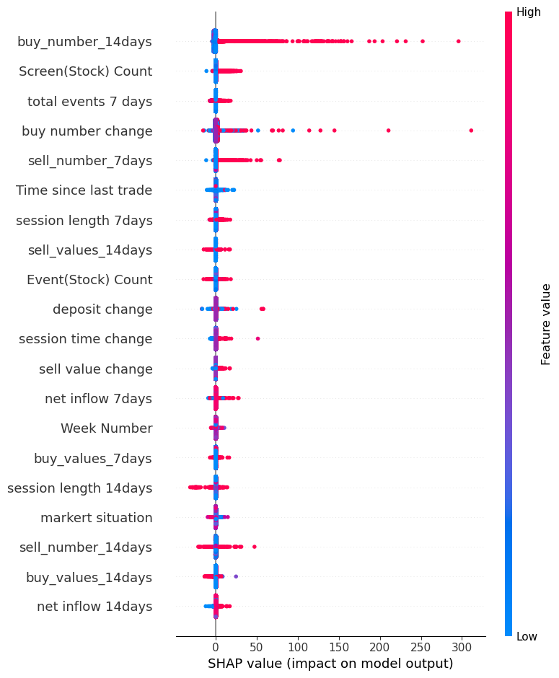
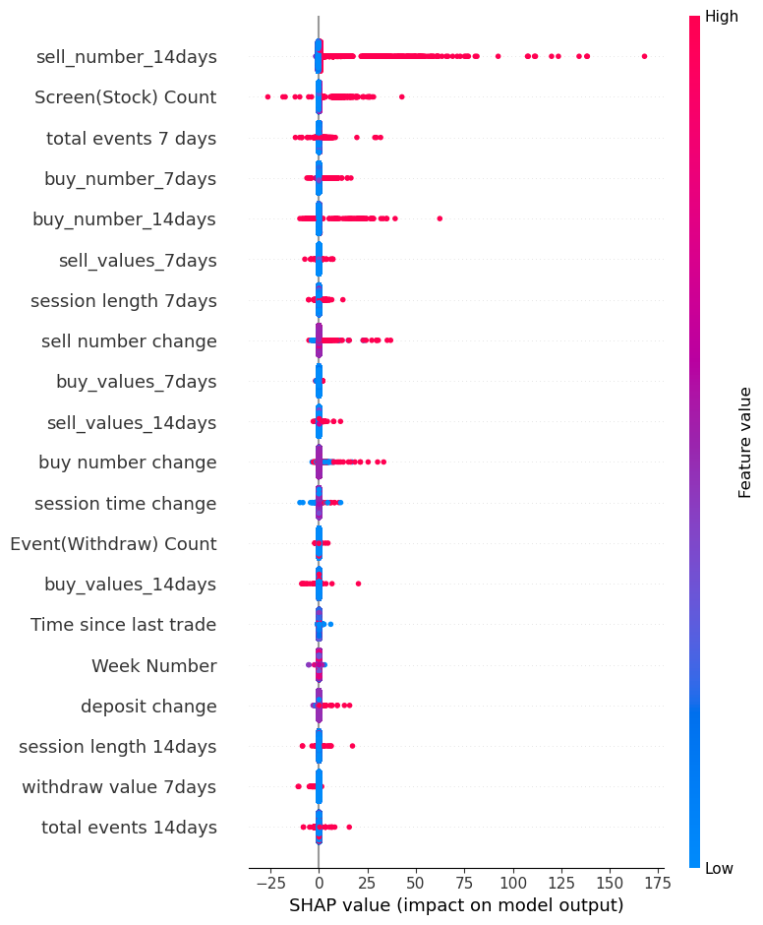
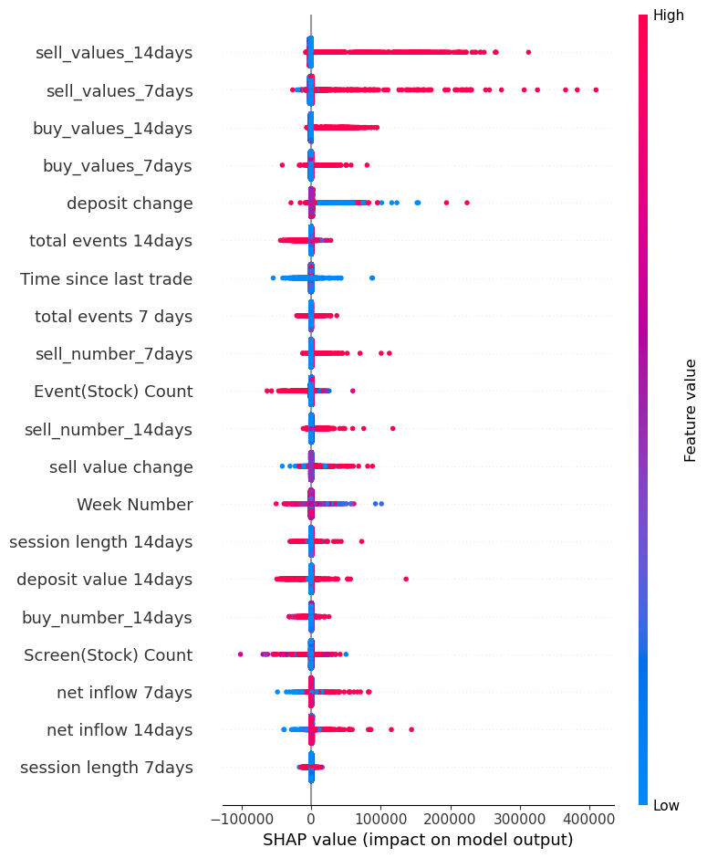
SHAP Value Analysis
Number of buy
Number of sell
Transaction value

Slide 7
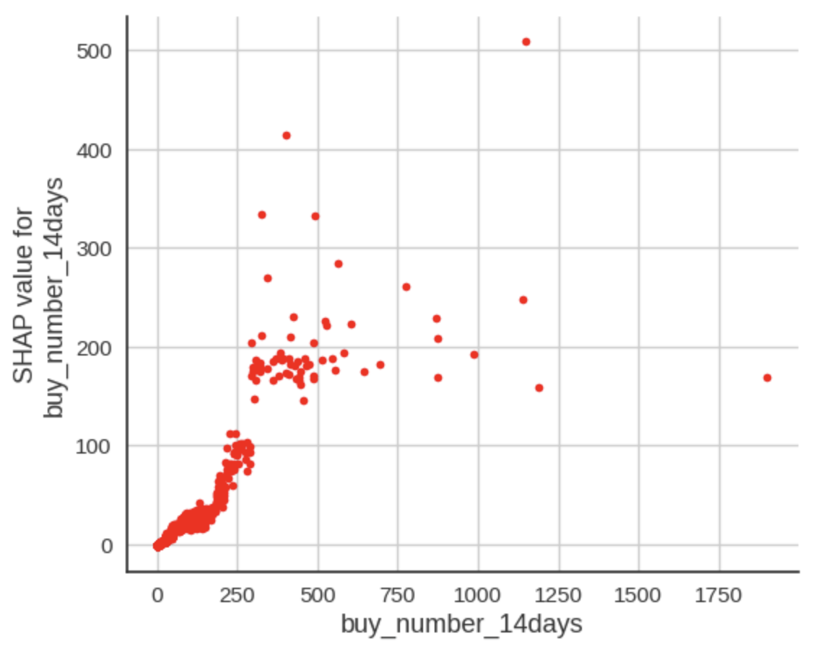
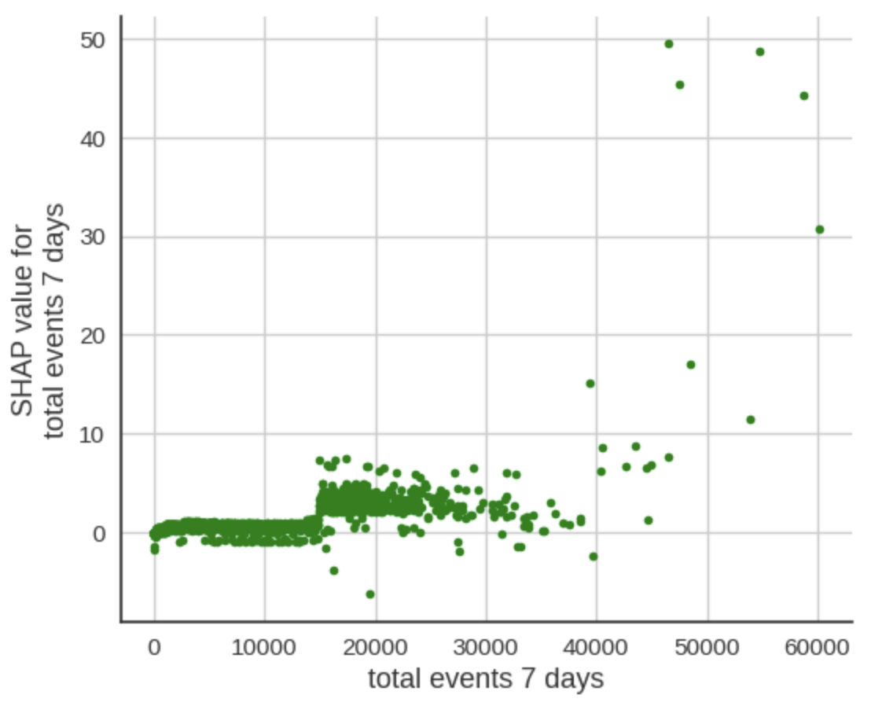
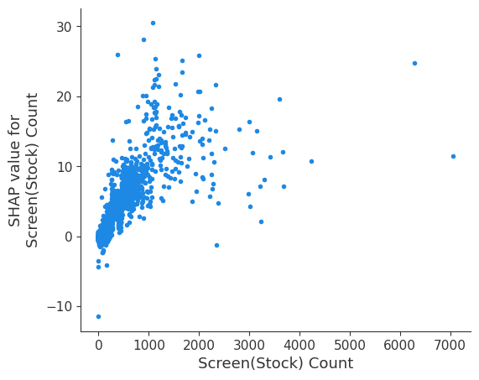
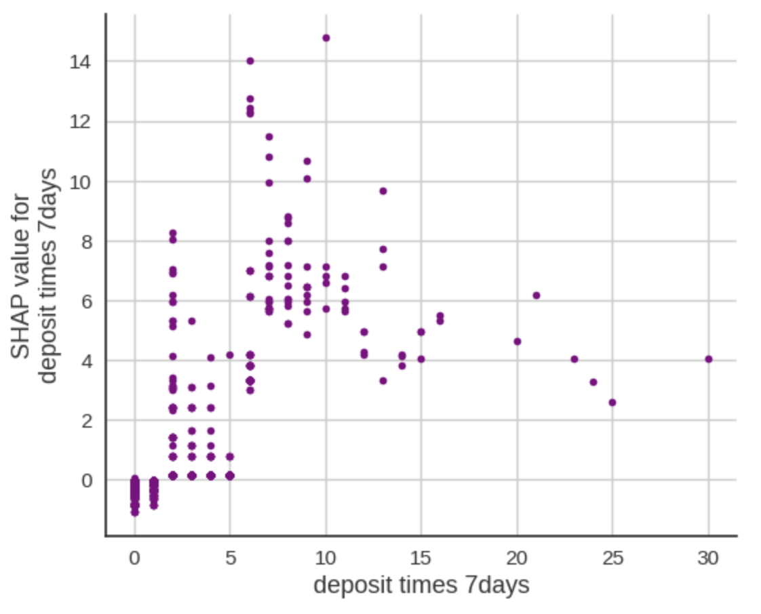
The causal drivers responsible for the number of buy/sell transactions a user will make in the next week
Observation:
Higher number of buy in the past 14 days may increase the number of buy the user will make in the next week.
The total events in past 7 days have a positive impact on the number of buy in next 7 days, especially after the 15000 total events.
The more stock-related screens a user visits, the more likely they are going to buy in the next week.
Increasing in the number of deposits in the past 7 days will increase the number of buy in the next 7 days, especially between 5 and 15.

Slide 8
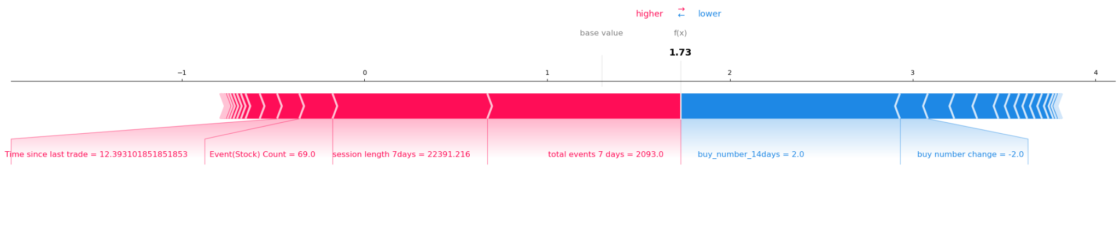
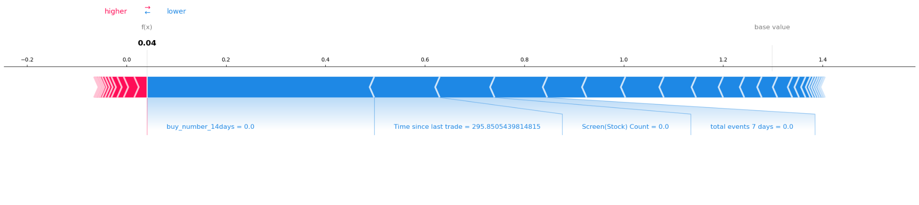
The causal drivers responsible for the number of buy/sell transactions a user will make in the next week
Predict value: High
Predict value: low
EXAMPLES:
It can be seen that for this user who is more likely to buy next week, User’s behavior and the time since the last transaction features are most affect the model's prediction.
The model primarily predicts based on the user's recent purchasing behavior for those users who may not intend to make purchases next week.

Slide 9
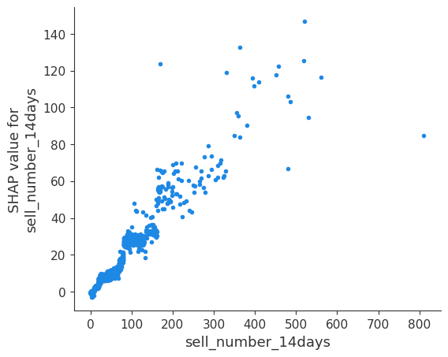
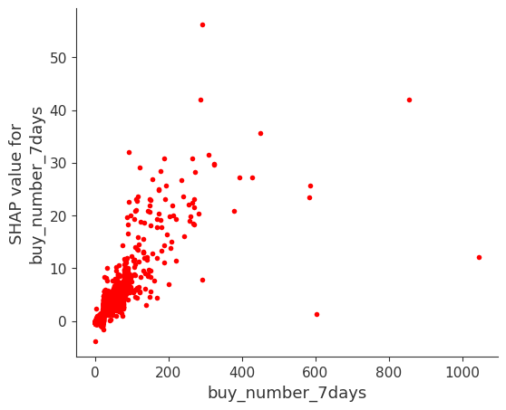
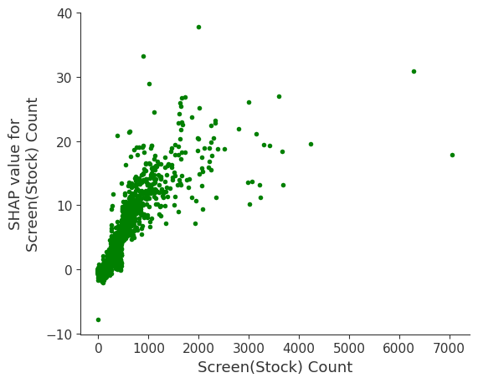
The causal drivers responsible for the number of buy/sell transactions a user will make in the next week
Observation:
Higher number of sell in the past 14 days may increase the number of sell that the user will make in the next week. Indicating that user purchasing behavior exhibits a certain level of continuity.
The increasing of the number of buy in the past 7 days may increase the number of sell of the user in next week. This indicates that the number of buys and sells by the user are mutually driving each other.
The more stock-related screens a user visits, the more likely they are going to sell in the next week.

Slide 10
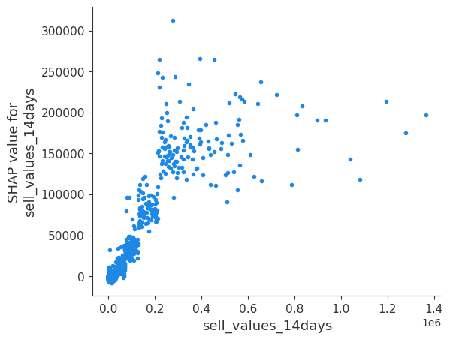
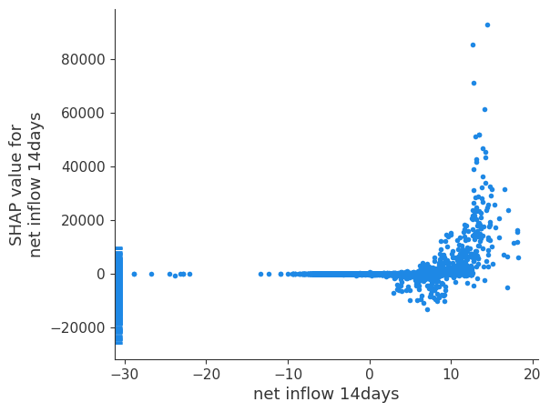
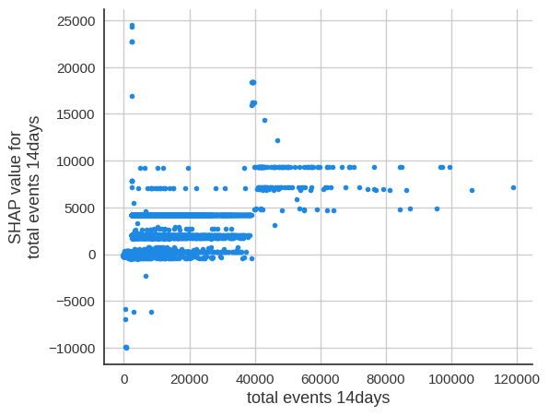
The causal drives responsible for the value of transaction
Observation:
The features that most significantly influence the user's trading volume next week are the user's sell value and buy value from the previous 7 and 14 days. These features have a linear relationship with the transaction value for the upcoming week.
When net flow < 0, the SHAP value is around 0, indicating total transaction in the next 7 days may decrease. While when net flow > 0, user’s total transaction in the future may increased.
When the total events > 40000, it has high impact on transaction value in the next 7 days. While lower total events may have less impact.

Slide 11
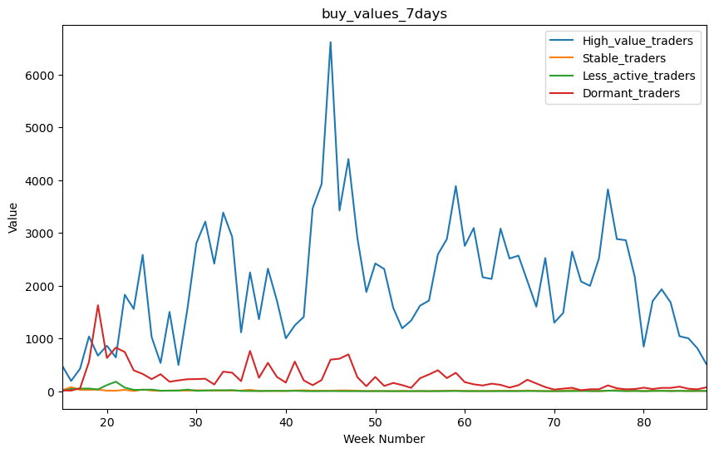
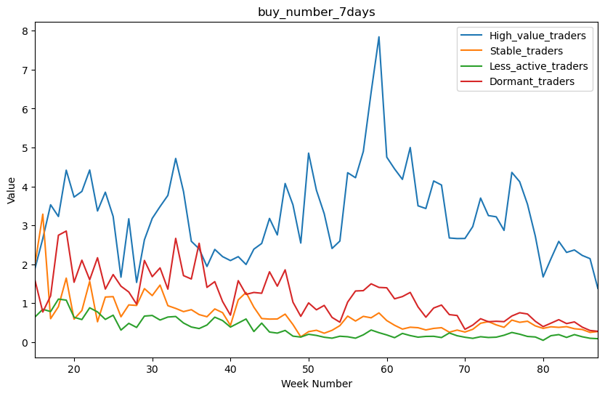
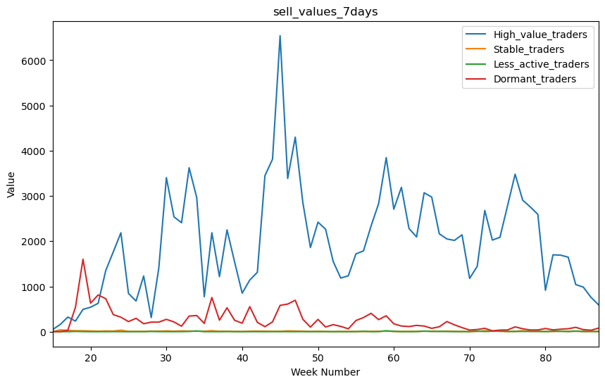
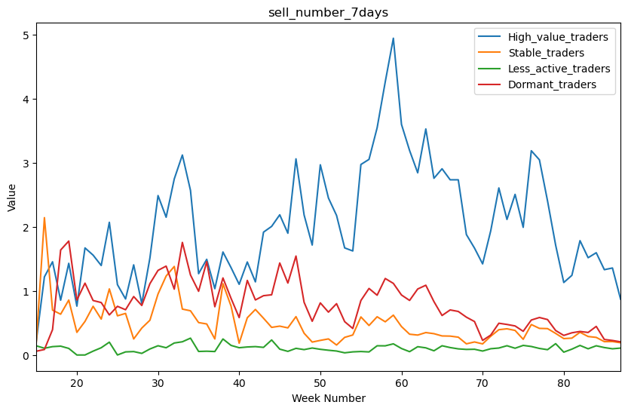
Model insights for the segments of users in Use Case 1
High value trading users
Highest trading volumes
Highest operation time
Stable trading users
High trading frequency
Low trading volumes
Low operation time
Less active trading users
Lowest trading frequency
Lowest trading volumes
“Dormant” Users
Highest churn percentage
Less activity after they churn

Slide 12
Marketing strategies
Build a traders community
Observation: The total events in past 7 days have a positive impact on the number of buy and transaction value in the future
Invite stock market experts to deliver some online lectures about different investment strategies or analysis of market trends.
(Observation: Number of sell and number of buy drives each other)
Users are allowed to post their opinion and investment experience in the community, so that other users can view what they have posted and make comment on it.
Gotrade can updates some market news in the community.
Segment of users based on their portfolio, recommend different articles for different segment of users.

Slide 13
Marketing strategies
Reward users base on their behaviours
When the user has not deposit for a period of time, we can offer them a small cash back after they deposit again.
(Observation: Increasing in the number of deposits will increase the number of buy)
When the user's total assets exceed a certain amount within a certain period of time, we can offer them rewards such as discounts in handling fee.
(Observation: Increasing withdraw value may result in a decrease in the total transaction)
Design an incentive plan triggered by net flow. When users weekly netflow is lower than zero, we can offer them rewards for their first trading next week.
(Observation: Net flow < 0, total transaction in the next 7 days may decrease)

Slide 14
Marketing strategies
Notification system
Establish a real-time notification system to inform users of significant changes in their net flow. Users will be notified when the value of the stocks held by them increases.
(Observation: Net flow > 0, total transaction may increase.)
Optimize UI design
Improve user experience by providing more interactive content, such as transitional animations or haptic feedback.
(Observation: The total events have a positive impact on trading in the future)
Place stock-related pages in the most interacting area on the screen, so that users can see stock-related information when they enter the main interface.
(Observation: Increasing times of visiting stock-related screens will increase trading.)

Slide 15
Thanks

Slide 16
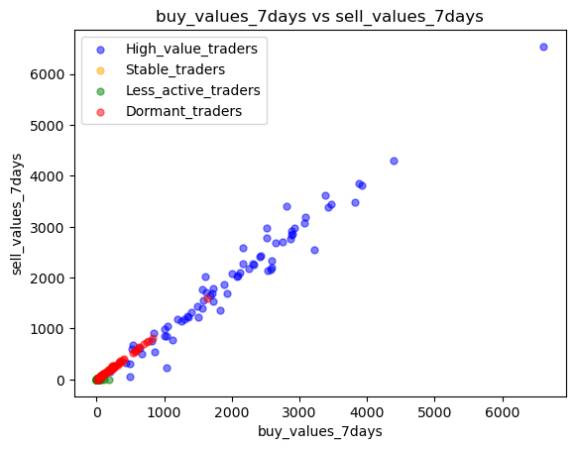
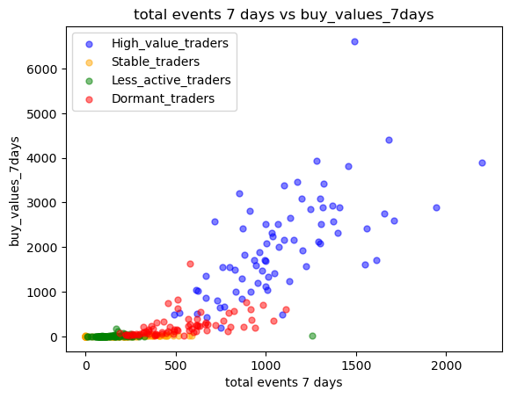
Supplementary material
High value trading users
Highest trading volumes
Highest operation time
Stable trading users
High trading frequency
Low trading volumes
Lowest churn percentage
Low operation time
Less active trading users
Observation:
The weekly buy value and sell value of the four groups of users are basically positively correlated. Which might suggest that they are the drivers of each other.
Buy value will increase with the number of total event times in a week. This is especially obvious in the high value trade user group.
Lowest trading frequency
Lowest trading volumes
Dormant Users
High trading volumes
Less activity after they churn

Slide 17
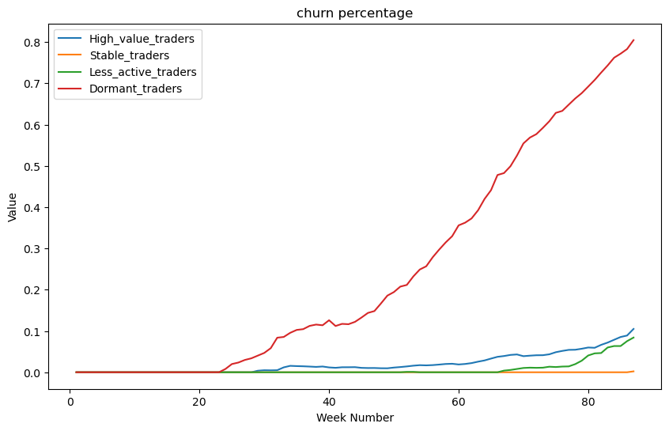
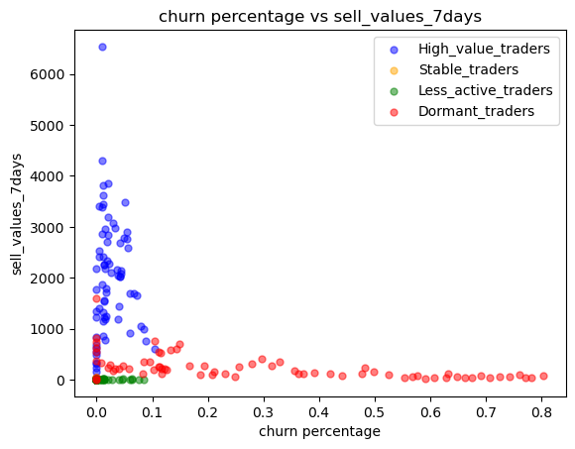
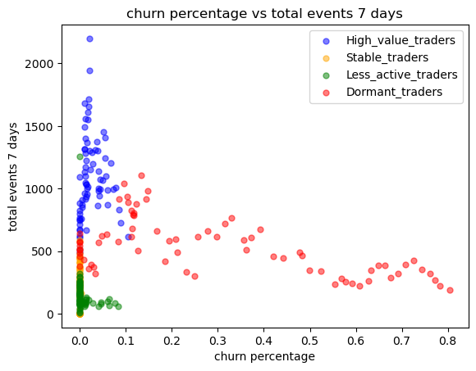
Supplementary material
High value trading users
Churn percentage:
The percentage of users who have already churn in this group of users.
Highest trading volumes
Highest operation time
Stable trading users
High trading frequency
Low trading volumes
Lowest churn percentage
Low operation time
Less active trading users
Lowest trading frequency
Lowest trading volumes
Dormant Users
High trading volumes
Highest churn percentage

